Slide 1

BATTLE OF THE NEIGHBORHOODS

Slide 2
Finding the best neighborhood to open the new offices.
Our client would like this to a neighborhood of Brooklyn. We will look at the similaries and differences of the differnt neighborhoods and propose our findings.

Slide 3
DATA SOURCES
https://geo.nyu.edu/catalog/nyu_2451_34572
https://www1.nyc.gov/site/finance/taxes/property-rolling-sales-data.page

Slide 4
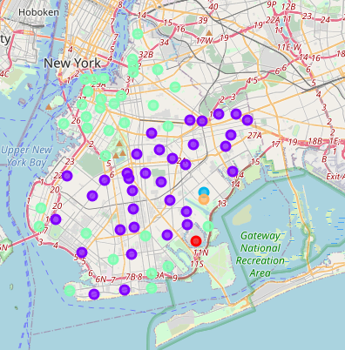
K- MEANS CLUSTERING
Using Foursquare API and K- meanings clustering we divided the 70 neighborhoods in Brooklyn to 5 clusters.
cluster 1 has 1 neighbourhood
cluster 2 has 35 neighbourhoods
cluster 3 has 1 neighbourhood
cluster 4 has 32 neighbourhoods
cluster 5 has 1 neighbourhood

Slide 5
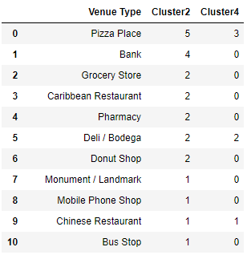
MOST COMMON TYPES OF VENUES
We now focus our analysis on cluster 2 (35 neighborhoods) and cluster 4 (32 neighborhoods).
The most types of venues and the count in the 2 clusters can are in the table on the right.

Slide 6
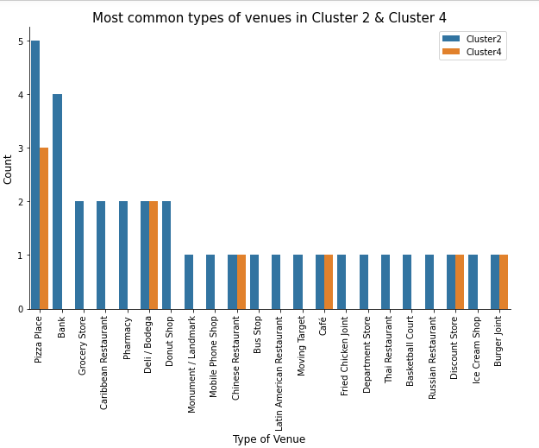
VENUES IN CLUSTER 2 & 4
The most common venues in both clusters are Pizza places.
Cluster 2 has a wider variety of venues than cluster 4.
Cluster 2 also has more venues than cluster 4.

Slide 7
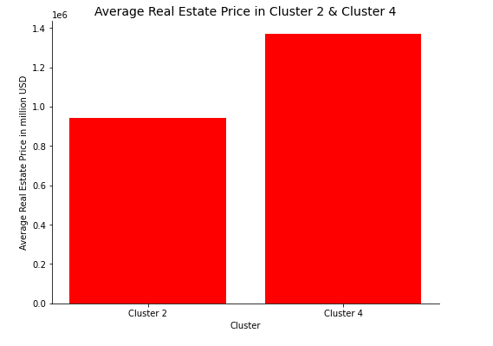
EXPLORATORY ANALYSIS ON REAL ESTATE PRICES
Average price for residential and commercial real estate prices in the 2 clusters were:
Cluster 2 : 940 792 USD
Cluster 4 : 1 369 005 USD

Slide 8
CONCLUSION
Based on the wide variety and number of venues in cluster 2 , combined with the lower real estate prices, the best option that would guarantee a better quality of life to its residents would be in a neighborhood in cluster 2.

